Slide 1
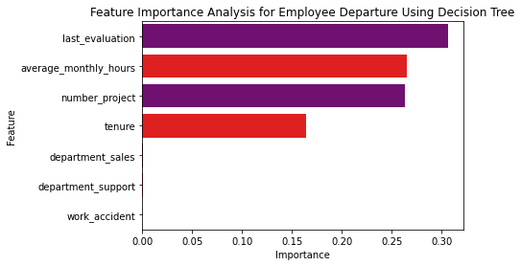
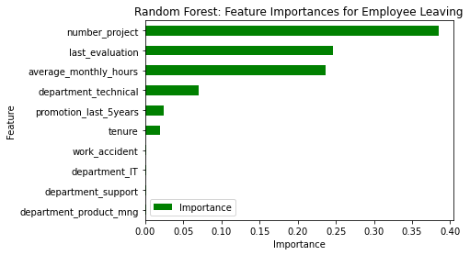
Salifort Motors
Employee Retention Project
The problem or issue is related to employee retention and factors contributing to employees leaving the company.
Specific issues include excessive workloads, dissatisfaction among four-year tenured employees, and the impact of working long hours on employee decisions.
The response includes the development and evaluation of predictive models, such as logistic regression and tree-based machine learning models to understand and predict employee retention.
Recommendations for addressing the issues contributing to employee attrition were proposed, including workload management, promotions, and fostering open discussions.
The barplot above shows that in the decision tree model, last_evaluation, number_project, tenure, and overworked have the highest importance, in that order. These variables are most helpful in predicting the outcome variable, left.
The findings from the models suggest that employees who work long hours are more likely to leave the company. This is likely because long working hours can lead to burnout, stress, and work-life balance problems.
The barplot above indicates that, within this decision tree model, last_evaluation, number_project, tenure, and overworked are the most crucial factors, ranked in that order. These variables play a key role in predicting whether an employee will leave the company.
Implement a cap on the number of projects employees can simultaneously work on.
Consider promoting employees who have completed four years with the company, or conduct in-depth investigations to understand the dissatisfaction among four-year tenured employees.
Evaluate options to either incentivize employees for working longer hours or reconsider workload expectations.
Ensure employees are well-informed about the company's overtime pay policies, and establish clear guidelines for workload and time-off expectations.
Foster open discussions at both company-wide and team-specific levels to gain insights into and address any issues related to the company's work culture.
Reassess the criteria for high evaluation scores to ensure that exceptional performance is recognized proportionately, irrespective of working extremely long hours.

